Slide 1

Stash
Decentralized Money Saving App
Page 01/12

Slide 2


why?
75%
of Indians DO NOT have an emergency fund
Page 02/12

Slide 3


enter
Stash
the smart piggy bank that turns your savings into a secure, self-growing financial reserve, so you’re always ready for life’s surprises
PRIVACY, SECURITY
Page 03/12

Slide 4
used
Technology
Frontend:
React (JavaScript/JSX), Vite (Build tool and development server)
Backend:
ICP Blockchain, Rust(Smart Contract)
Page 04/12

Slide 5
core
features
Built on the Internet Computer Protocol (ICP)
Leverages blockchain for transparency and security
Earn interest on savings with customizable lock-in periods
Real-time balance updates and transaction history
Page 05/12

Slide 6
core
features
Deposit INR with three lock-up options (3, 6, 12 months)
Withdraw funds post lock-in period or with early withdrawal penalty
Detailed records: amount, type, lock period, interest, date/time
Internet Identity integration for secure logins
Page 06/12

Slide 7
next
steps
Short Term:
Finalize stable coin integration and UI polish
Conduct comprehensive testing and deploy on testnet
Long Term:
Integrate real fiat on/off ramps
Expand reward features and user engagement
Page 07/12

Slide 8
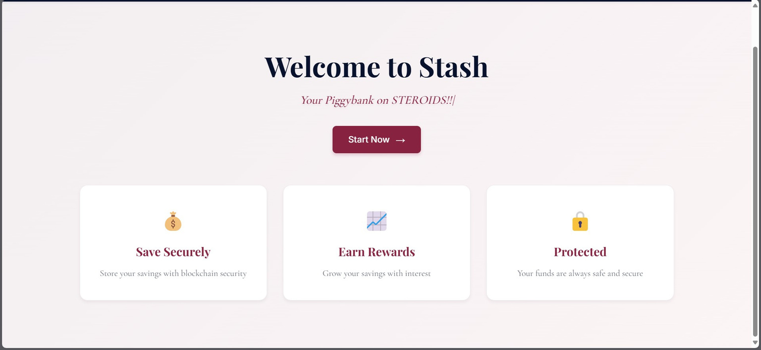
demo
Page 08/12

Slide 9
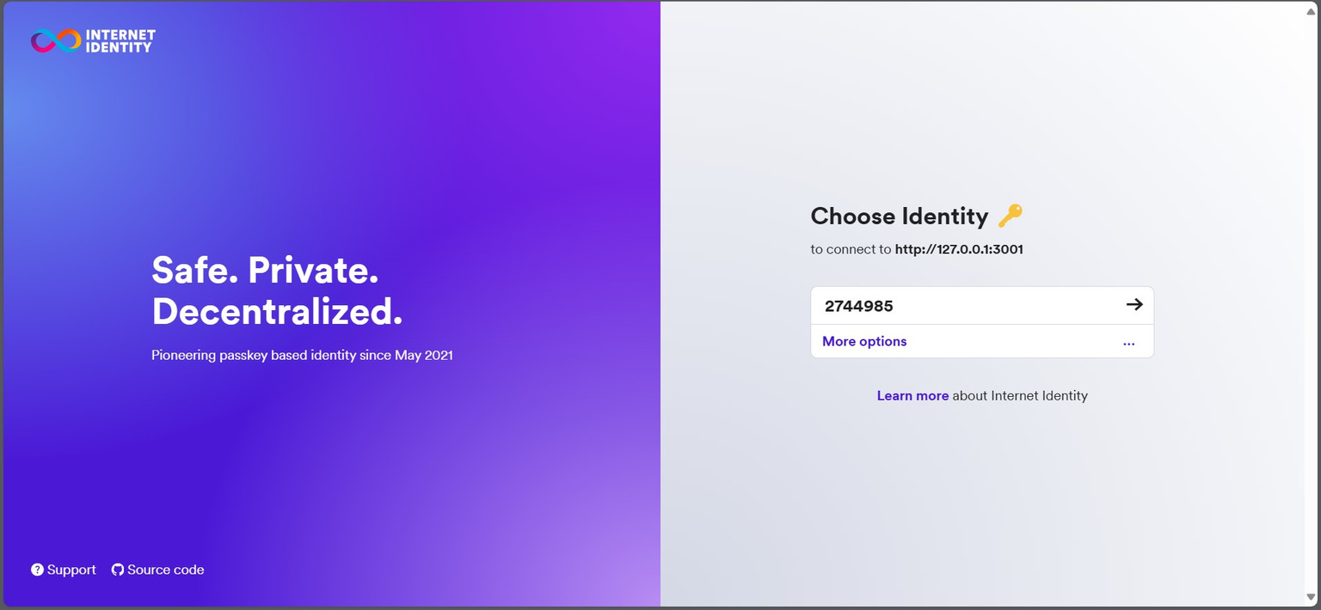
demo
Page 09/12

Slide 10
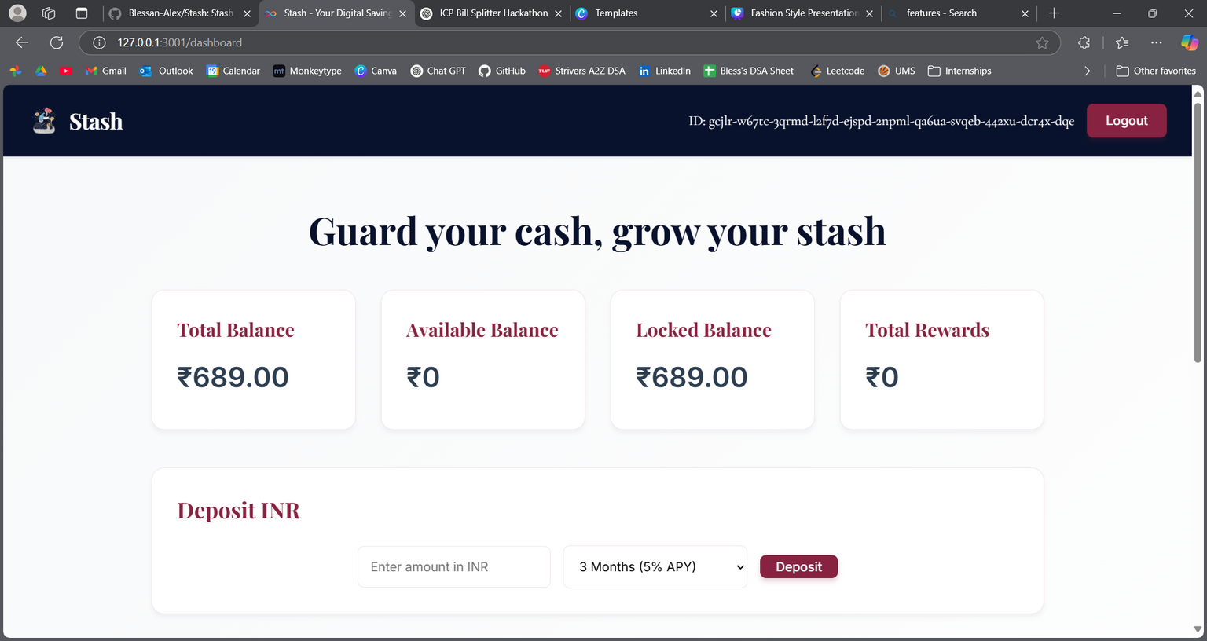
demo
Page 10/12

Slide 11
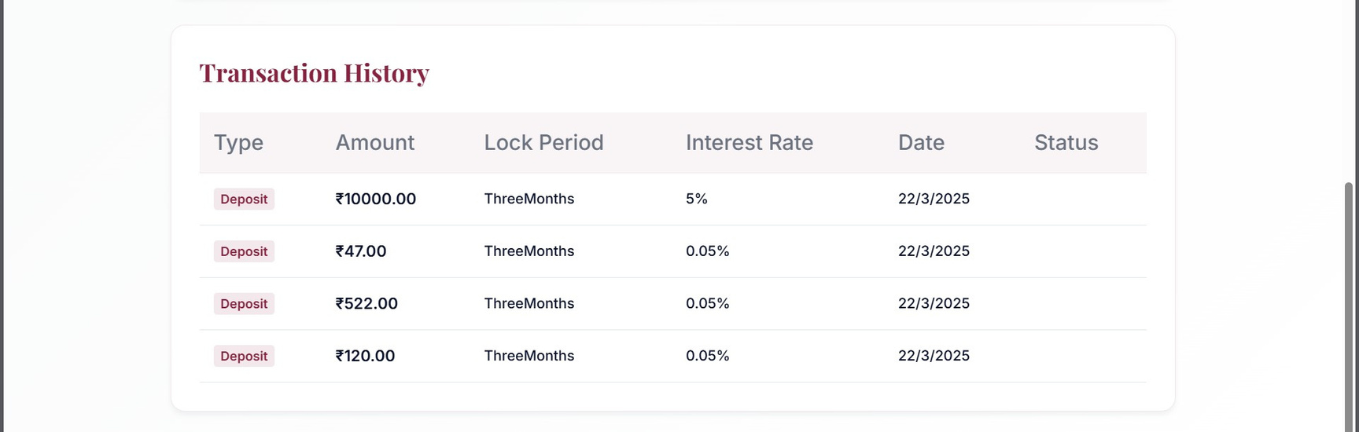
demo
Page 11/12

Slide 12
details
blessan alex
9188563150
Team Deccan
Page 12/12

